Slide 1


Sales Analysis

Slide 2
Overview
Analyzing sales data and uncover sales trends over time, finding key metrics, connection between different aspects of sales and guiding in smarter strategies for successful business.

Slide 3
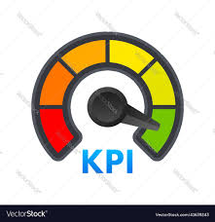
Key Performance indicators
137.35M Total Sales
79.09M Offline Sales
58.25M Online Sales
19.10K Total Cost
44.17M Total Profit
513K Sold Units

Slide 4
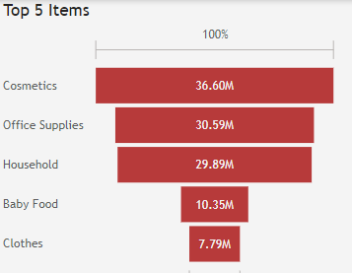
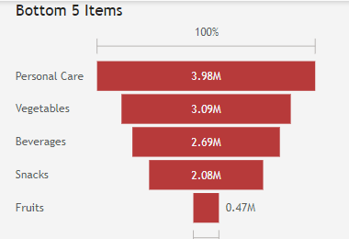
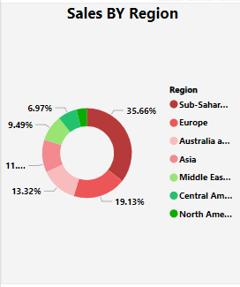
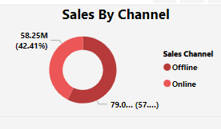
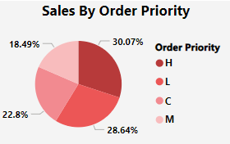
Sales Trends

Slide 5
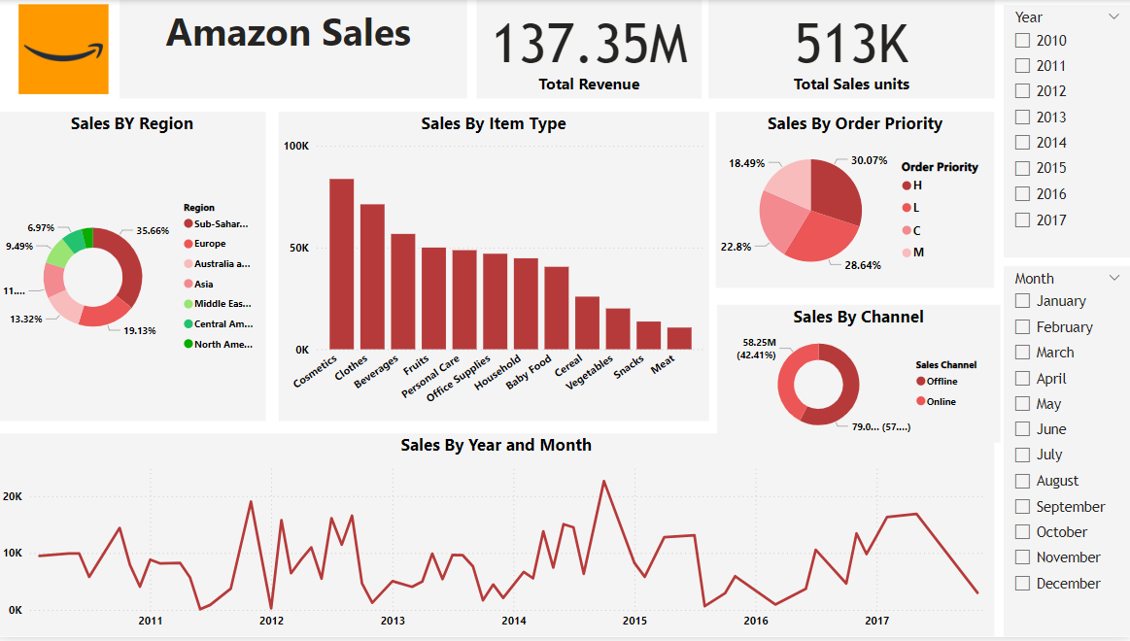
Sales Dashboard

Slide 6
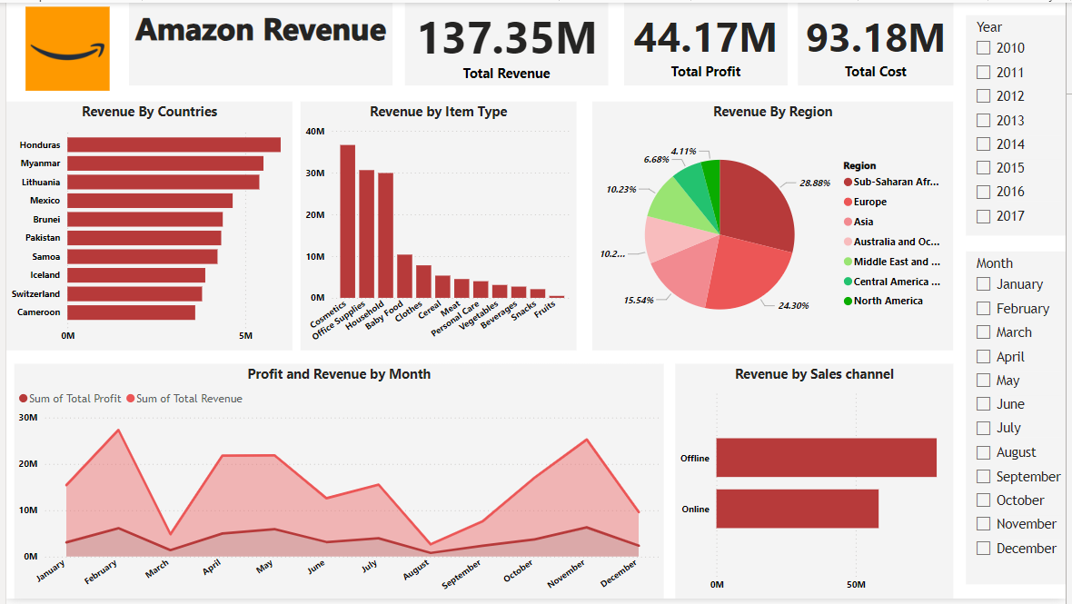
Revenue Dashboard

Slide 7
Trends
Top 5 sold items are cosmetics, office supplies, Household, Baby food and Clothes
Bottom 5 sold items are Personal care, Vegetables, Beverages, Snacks and Fruits.
Based on region Sub-Saharan Africa has highest sales followed by Europe and Australia least sales is in North America and Central America.
Offline Sales is higher than Online sales.
Order priority is higher for H type.

Slide 8
Yearly Sales
S.No | Year | Total Sales
1 | 2010 | 19.19M
2 | 2011 | 11.13M
3 | 2012 | 31.90M
4 | 2013 | 20.33M
5 | 2014 | 16.63M
6 | 2015 | 12.43M
7 | 2016 | 12.37M
8 | 2017 | 13.37M
 | Total | 137.35M

Slide 9
Recommendations
Based on Analysis:
February and November seems to have highest sales. We can multiply our sales by introducing special offers and discounts for our top selling products during those months.
Improving sales of least sold products by enhancing product features, educating customers, customer reviews and testimonials, promotional offers and pricing strategy
Enhancing customer reviews and referral offers help us to attract new customers and retain our existing customers
Optimize online orders by user friendly design, improving loading speed, product presentation, social media marketing and personalized recommendation.

Slide 10


